Slide 1
Orientation & Safety
Firefighter I
North Carolina Fire & Rescue Commission
Orientation & Safety
Updated 11/2011

Slide 2
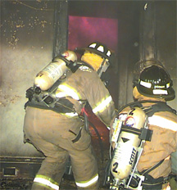
Lesson One Firefighter I
TERMINAL OBJECTIVE
The Firefighter I candidate shall correctly describe in writing the mission of the fire service, and the mission of the fire department in relation to the local jurisdiction and its member firefighters.

Slide 3
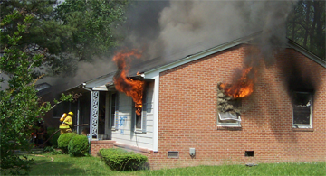
Enabling Objectives
The Firefighter I candidate shall correctly define in writing the mission of the fire service.
The Firefighter I candidate shall correctly define in writing the mission of the fire department.

Slide 4
Enabling Objectives
The Firefighter I candidate shall correctly describe in writing the components of the fire department member assistance program.
The Firefighter I candidate shall correctly describe in writing the importance of physical fitness and a healthy lifestyle to the performance of the duties of a firefighter.

Slide 5
Mission of the Fire Service
Mission refers to a broad, long-range goal that is the result of a conviction or aim.
A range of ideas that all focus toward a single concept can inspire this conviction or aim.
A mission can belong to a single person, a group of people, an organization, or an entire profession.

Slide 6
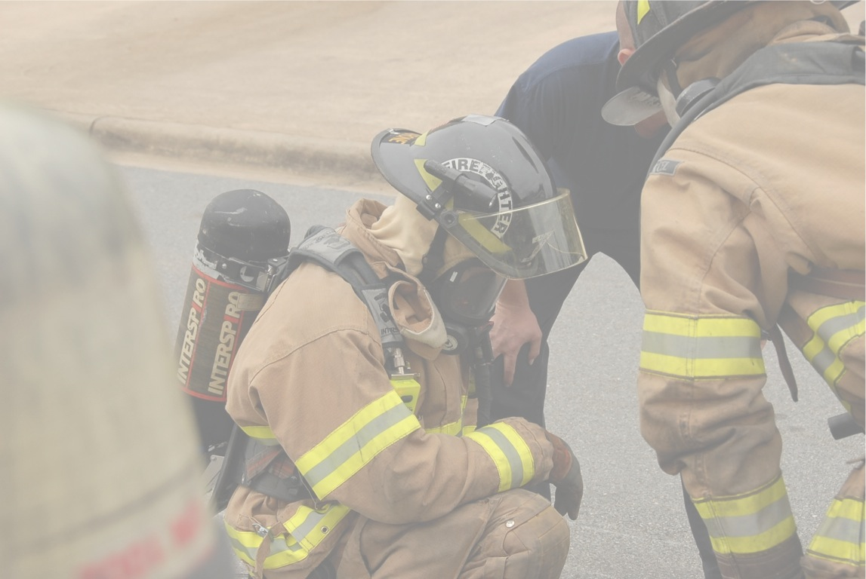
Mission of the Fire Service
The mission of the fire service is to reduce and eventually eliminate deaths, injuries, and property damage due to fire.

Slide 7
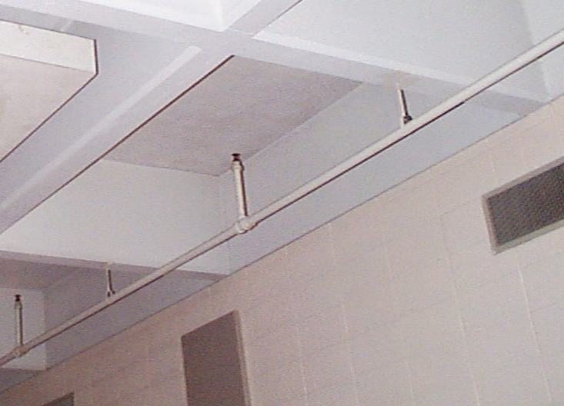
Technology
Technology is on the advance and has proven to be a double edged sword.
Vast strides in the detection of fire and automatic extinguishing systems have greatly aided the fire service.

Slide 8
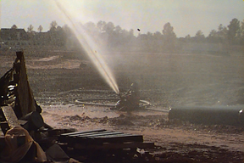
Technology
On the other hand, the preponderance of petrochemical products has greatly intensified the overall fire problem.
The single most difficult problem is the human
  element; a lack of
  education about
  fire throughout
  the general public
  ranks as the most prevalent cause of uncontrolled fire.

Slide 9
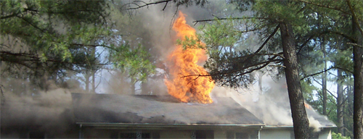
Mission of the Fire Dept.
The Mission of the Fire Service and the Fire Department are similar.
However, the local fire department may approach the mission of the fire service in several ways.
Its overall purpose is to point out how the fire department will protect its citizens.

Slide 10
Mission of the Fire Dept.
The local fire department mission will focus on its particular jurisdiction rather than on a state or national level.
Additions to the mission statement may include the well-being of the firefighters and enhanced levels of fire education for local citizens.

Slide 11
FD Member Assistance
Pension Fund: The Fireman’s and Rescue Squad Worker’s Pension Fund is a voluntary, supplemental retirement program.
At present membership is
$10.00 per month, up to a
total payment of $2,400.00.
Members become eligible to
receive payments upon 20
years service and upon
reaching age 55.

Slide 12
FD Member Assistance
The Fireman’s Relief Fund: The “relief fund” was implemented to provide financial aid to fire department members. Money for the fund is collected from a tax levy of ½ of 1% on fire insurance premiums within the rated fire district. This fund provides financial aid to the firefighter and his family in the event of serious injury, sickness or death as a result of fire department operations.

Slide 13
FD Member Assistance
Workers Compensation: This is a compulsory insurance that covers illness, injuries, or death caused by traumatic injuries that occur while performing the duties of a firefighter.

Slide 14
FD Member Assistance
Fireman's Death Benefit (Federal): This is a death benefit paid to the surviving immediate family members or the estate of the deceased firefighter by the Federal Government for a line of duty death in the fire service of North Carolina.

Slide 15
FD Member Assistance
Wellness Programs: Medical research has proven that firefighters participating in a structured exercise program (usually found in paid fire departments) are less likely to suffer stress related illnesses. Wellness programs provide structured exercise programs along with counseling on stress, diet, and social interaction.

Slide 16
FD Member Assistance
Member assistance programs can come in many forms and varieties, all types of counseling can be offered, e.g. legal, financial, marriage, psychiatric, etc. Review the member assistance programs in existence within the fire department including CISD (Critical Incident Stress Management) teams.

Slide 17
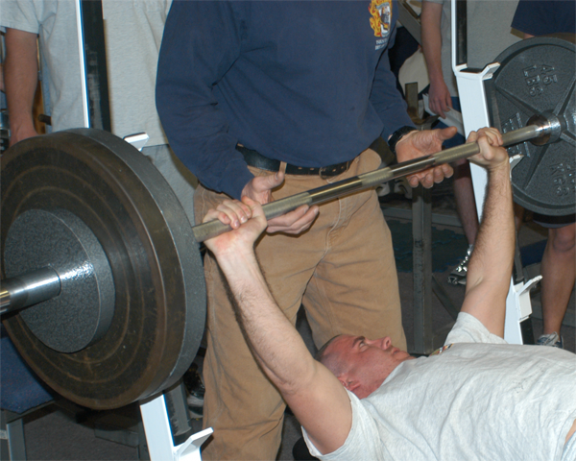
Physical Fitness
Healthy lifestyles are essential for overall firefighter fitness.
There are a variety of programs available to assist fire departments in sustaining healthy lifestyles.

Slide 18
Review
Review the mission statement of the fire service and how it affects the goals of the fire department.
Restate the mission of the respective fire department and discuss those amendments that go beyond the mission of the fire service.

Slide 19
Review
Briefly list and discuss all of the pertinent member assistance programs and open the class for any questions.
Reinforce the need for a physical fitness policy.

Slide 20
Lesson Two Firefighter I
TERMINAL OBJECTIVE
The Firefighter I candidate shall correctly describe in writing the organization of their respective fire department, and their position within the organization.

Slide 21
Enabling Objectives
The Firefighter I candidate shall correctly describe in writing the organization of the fire department.
The Firefighter I candidate, when given a blank form and list of all positions, shall correctly identify each of the positions located on the fire department organizational chart.

Slide 22
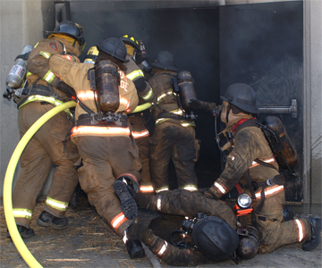
Organization of the FD
The fire department is a collective group of people that function within a prescribed framework.
This framework allows for a logical sequence in the dissemination of authority and provides for a means of control.

Slide 23
Unity of Command
Each individual participating in the operation reports to only one supervisor. This eliminates the potential for individuals to receive conflicting orders from a variety of supervisors, thus increasing accountability, preventing freelancing, improving the flow of information, helping with the coordination of operational efforts, and enhancing operational safety. This concept is fundamental to the Incident Command System chain of command.

Slide 24
Division of Labor
The major concept behind ICS is that every emergency, no matter how large or small, requires that certain tasks, or functions, be performed. The organization can expand or contract according to the size of the emergency and the staff available. The primary functions of the ICS are: Incident Command, Operations, Logistics, Planning/Intelligence, and Administration/Finance.

Slide 25
Organization of the FD
When working with predominantly volunteer fire departments, the Board of Directors will have a position on the chart with the Chairman and President in sub-positions.

Slide 26
Organization of the FD
When working with a municipal fire department, the city manager will have a position on the chart along with the city council and mayor.
Where a municipal government does exist, the personnel ordinances will dictate the actual positions of administrative personnel.

Slide 27
Fire Department Positions
Fire Chief: the Chief of the department is an administrator of affairs of the fire department, both on a business level and at the combat level. Depending on the size and complexity of the department, the Fire Chief’s actual involvement in the combat role may vary. However, the Fire Chief is ultimately responsible for everything that the fire department does. The Fire Chief answers directly to the City Manager in a municipality or to the board of directors in a volunteer organization. They, in turn, would answer to citizens of the respective jurisdiction.

Slide 28
Fire Department Positions
Deputy Chief: The Deputy Chief is an administrator of both business and combat operations within the fire department and acts directly on behalf of the Fire Chief. In the Fire Chief’s absence the Deputy Chief is in overall control of the department. Depending on the size and complexity of the fire department, the Deputy Chief’s role is active combat operations may vary. However, the Deputy Chief is responsible for all actions taken by personnel under their command.

Slide 29
Fire Department Positions
Assistant Chief: Existence of this position usually indicates a fairly large fire department. The major responsibility of this position is usually that of shift or division command. This entails the administration of an entire shift or division of personnel as well as an active combat command role. When a Deputy Chief is not part of the organizational structure of the fire department, then the assistant chief will assume the role of Deputy Chief.

Slide 30
Fire Department Positions
Battalion Chief: Battalion Chiefs are most likely to be found in large fire departments and are responsible for the administration of a given zone or section of the jurisdiction (units and stations within a jurisdiction). Battalion Chiefs usually maintain an active combat command role.

Slide 31
Fire Department Positions
Captain: Captains are generally responsible for the administration of a single station or where the position of Battalion Chief is not used, they may fill that position. Captains may also regularly administer functions in the fire department e.g., Fire Prevention Officer, Arson Investigator, or Public Fire Educator. Captains are usually the initial Incident Commander on combat operations.

Slide 32
Fire Department Positions
Lieutenants: Lieutenants are generally responsible for a single company or crew of personnel, e.g., an engine company, truck company or ladder company. They act as managers for a small group or unit of fire department personnel, both in fire department business and combat operations. The company is the basic unit of the fire department.

Slide 33
Fire Department Positions
Fire Prevention Officer: Depending upon the size of a department and the size of the jurisdiction, a fire department will have a fire prevention officer and can have a fire prevention bureau. This position usually entails providing fire inspections by a fire inspector the assimilation of pre-incident surveys, and public fire education. This is usually a staff position, but in some cases requires a combat role as in public information and determining origin and cause of a fire. Also this position usually plays an active role in arson investigation. The position is sometimes referred to as Fire Marshal.

Slide 34
Fire Department Positions
Training Officer: The Training Officer is responsible for the training of all fire department personnel. The Training Officer maintains all training records and oversees all testing within the fire department. The development of specific programs and classes, entrance exams and certifications fall under this position. In large fire departments, a chief of training may exist with a complete staff of subordinate officers. In small fire departments, this is usually ranked as a Captains position. During training evolutions, the Training Officer is in complete control and all personnel (except the Fire Chief) answer to this position. The main reason for this is safety. The Training Officer must reinforce that training must be continuous.

Slide 35
Fire Department Positions
Driver / Operator: The Driver / Operator is primarily responsible for driving the fire apparatus to the incident and correctly spotting the apparatus for the given function required. Since there are several different types of apparatus, and the function of an apparatus may be specific, the Driver / Operator may need to be certified in several areas, e.g., pump operator, aerial apparatus operator, or tanker operator. In all cases the Driver / Operator should be certified under the North Carolina Driver / Operator Standard.

Slide 36
Fire Department Positions
Firefighter: The firefighter is responsible to carry out the ordered actions of his or her superiors, both in fire department business and in combat. There may be multiple levels of the firefighter position, Fire I and Firefighter II; depending on the level of certified training and in some cases minimum years of service. The firefighter must be skilled in combating, extinguishing, and preventing fires. Firefighters must be able to answer emergency calls property, perform suppression and/or rescue operations; also they need to know how to operate the various types of equipment and apparatus used by the fire department. Firefighters should have a working knowledge of basic fire prevention methods and procedures.

Slide 37
Review
Review the entire organizational structure of the fire department and the responsibilities of each position within that organizational structure. This will reinforce the concept and answer any additional questions.
Summarize the Firefighter I candidate’s role and their respective responsibilities within the fire department organization.

Slide 38
Lesson Three Firefighter I
TERMINAL OBJECTIVE
The Firefighter I candidate shall correctly define and describe in writing the fire department guidelines under which fire department personnel operate at all times.
SOPs
SOGs

Slide 39
Enabling Objectives
The Firefighter I candidate shall correctly explain in writing the function of the S.O.P.s or S.O.G.s.
The Firefighter I candidate shall correctly explain in writing the rules and regulations of the fire department as they pertain to the firefighter.
SOPs
SOGs

Slide 40
Enabling Objectives
The Firefighter I candidate shall correctly explain in writing the basic components of the Incident Command System and the role of the firefighter within that system.
The Firefighter I candidate shall correctly explain in writing the role of other agencies that may respond to emergencies.

Slide 41
Procedures / Guidelines
Standard Operating Procedures are the basic guidelines (policy oriented) that dictate set methods to accomplish the goals of the fire department. That goal or task may be how to roll a hose or communicate by radio.
SOPs

Slide 42
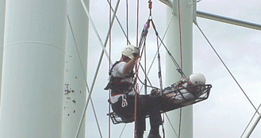
Procedures / Guidelines
Procedures allow for expediency and common knowledge between the issue of an order and the completion of that order by fire department personnel.

Slide 43
Procedures / Guidelines
“Standard” means that an accepted and approved method exists by which an action or function may be performed.
The word “procedure” means a method, step by step, by which to accomplish a task.
The key word “operating” means to actively do or perform, take action, or initiate. When all three definitions are applied together it becomes simple to define an S.O.P.

Slide 44
Procedures / Guidelines
The function of the fire department’s S.O.P.s is to insure that all fire department personnel know how to perform in any given situation and that all superior officers know what to expect from their subordinates for any given situation.

Slide 45
Procedures / Guidelines
Fire department S.O.P.s will vary somewhat with each individual fire department; therefore, it is beneficial for fire departments subject to mutual aid to have a basic knowledge of their sister fire department’s S.O.P.s where interactive operations are concerned.

Slide 46
Procedures/Guidelines
If a personnel ordinance is used in a governmental format, standard operating procedures or departmental policies cannot supersede governmental policies or procedures.
S.O.G.s are more flexible and useable by line officers and therefore are used more often than S.O.P.s

Slide 47
Rules & Regulations
Fire Department Rules and Regulations are the policy-oriented edicts that govern day-to-day functions of fire department personnel.
In order to maintain an effective, safe and efficient organization, fire departments must first establish guidelines that address possible and probable situations that occur.
Within this framework, personnel can in many circumstances, function without the need for direct supervision and can make decisions.

Slide 48
Rules & Regulations
Rules and regulations dictate everything from dress code, rules against coming into work intoxicated, how to act during a given set of circumstances, or what time to report for duty.
They also dictate those appropriate disciplinary measures used in the event a rule or regulation is violated, thus assuring fairness to all personnel.

Slide 49
Incident Command System
the Incident Command System (ICS) defines how the chain of command forms and progresses through any given operation.
ICS establishes the guidelines for an authority to be used to control all functions during an incident.

Slide 50
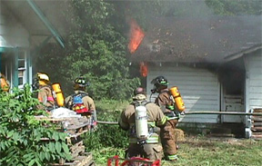
Incident Command System
A key point in ICS is the manageable span of control by one person with the ratio being one to seven with the optimum of five.
One person can effectively manage five subordinates.

Slide 51
Incident Command System
ICS Functional areas:
  Command.
  Operations.
  Planning.
  Logistics.
  Finance.
Most incidents will not require all of the tools in the toolbox.

Slide 52
Incident Command System
ICS can provide for different kinds of operations.
  Single jurisdiction / single agency involvement.
  Single jurisdiction / multiple agency involvement.
  Multiple jurisdiction / multiple agency involvement.

Slide 53
Incident Command System
In order for the firefighter to function within the ICS correctly they must first understand the components of ICS.
  Common Terminology.
  Modular Organization.
  Integrated Communications.
  Unified Command Structure.
  Consolidated Action Plans.
  Manageable Span of Control.
  Designed Incident Facilities.
  Comprehensive Resource Management.

Slide 54
Incident Command System
The firefighter may fit into several different units.
  A “crew” is a specified number of personnel without an apparatus who are assembled for a task and who have a common leader.
  A “single resource” could be an engine, squad, ladder truck, rescue crew, etc.
  A “task force” is a group of any type or kind of resources, with common communications and a leader, temporarily assembled for special tactical missions.
  A “strike team” is a specific number of the same kinds and type of resources with a common leader and common communications. In other words the firefighter is a part of a resource within the ICS.

Slide 55
Incident Command System
When the resources for an incident have been identified, then the IC can set up “divisions.”
  A “division” is an organizational level responsible for operations within a specific geographical location at the incident, such as the interior of a building. The firefighter may become part of a division.

Slide 56
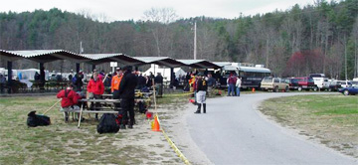
Incident Command System
Firefighters might become a part of a “group."
  A “group” is an organizational level responsible for a specific function at an incident such as a “ventilation group” or “salvage group."

Slide 57
Incident Command System
By using divisions and groups, the IC can control tactical operations at the incident through division / group supervisors.
This reduces the number of personnel the IC must deal with and provides for a better span of control with less confusion.

Slide 58
Incident Command System
When an incident becomes so large, that division and group leaders are too numerous. A “branch” is then created to maintain the span of control.
  A “branch” is an organizational level between the IC and the division / group leaders, Operations, or Logistics.
  A branch is responsible for implementing the portion of the incident action plan appropriate for that particular branch. They are most commonly used in Operations or Logistics Sections.

Slide 59

Incident Command System
“Staging” is a critical function of any type of incident. It allows for the orderly deployment of resources from a nearby location.
On large operations staging will fall under the operations officer, otherwise the IC will control staging.

Slide 60
Allied Agencies
When an emergency occurs and the fire department responds, there may be a need for other types of agencies to respond as well.
  EMS
  Law Enforcement
  Rescue Squad
  ETC…

Slide 61
Allied Agencies
All agencies that respond to an emergency must function within the framework of the Incident Command System.
The Incident Commander is responsible for all operational activity and therefore, is in control of or at least aware, of any operation being performed at the incident.

Slide 62
Allied Agencies
When a large incident occurs involving multiple agencies, a liaison officer will be used to coordinate between the IC and the agency representatives.
Liaison officers must be diplomatic when dealing with agencies unfamiliar with the ICS.

Slide 63
Allied Agencies
Local Agencies
  Mutual Aid Fire Department Response (two or more departments responding together)
  Emergency Medical Services
  Rescue Squad
  City and/or County Law Enforcement
  County Health Department
  Gas Company
  Electrical Companies like Duke Power, CP&L
  Private Industry (Haz Mat Incidents)
  Construction Companies

Slide 64
Allied Agencies
State Agencies
  NC Environmental Protection Agency
  NC State Fire Marshal
  NC State Bureau of Investigation
  NC Highway Patrol
  NC OSHA
  NC Department of Transportation
  NC Forest Service
  NC Department Health

Slide 65
Allied Agencies
Federal Agencies
  US Department of Alcohol, Tobacco and Firearms and Dangerous Explosives
  Federal Bureau of Investigation
  Environmental Protection Agency
  OSHA
  US Forestry Service
  US Department of Transportation
  US Coast Guard
  Federal Aviation Administration
  Nuclear Regulatory Commission

Slide 66
Review
Review the function of the fire department S.O.P.s and how they affect each individual firefighter within the organization.
Review the key points concerning the fire department rules and regulations, and how they govern the fire department personnel in day-to-day operations.

Slide 67
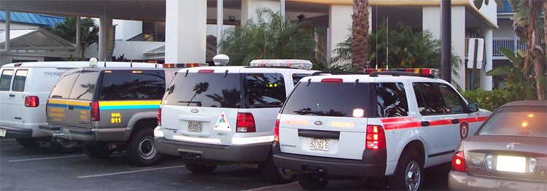
Review
Review and list the basic components of the ICS and reiterate the role of the Firefighter I within the ICS.
Review the roles of outside agencies and their responsibilities within the ICS.

Slide 68
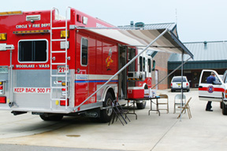
Lesson Four Firefighter I
TERMINAL OBJECTIVE
The Firefighter I candidate shall correctly identify and define in writing their responsibilities in a fire department safety program and the elements of an incident personnel accountability system.

Slide 69
Enabling Objectives
The Firefighter I candidate shall correctly identify in writing the firefighter’s responsibilities in a fire department safety program.
The Firefighter I candidate shall correctly identify in writing the elements of an incident personnel accountability system.

Slide 70
NFPA 1500
NFPA 1500, Standard on Fire Department Occupational Safety and Health Program, was developed to provide a consensus standard for an occupational safety and health program for the fire service.
The intent of this standard is to provide the framework for a safety and health program for a fire department or any type of organization providing similar services.

Slide 71
NFPA 1500
Chapter 4 – Section 4-4 Roles and Responsibilities
This section places responsibility on the fire department to research, development, implement, and enforce an occupational safety and health program.
The program should be designed to recognize and reduce operational risks.

Slide 72
NFPA 1500
Each individual member of the fire department shall:
  Cooperate.
  Participate.
  Comply with the provisions of the occupational safety and health program.

Slide 73
The Safety Program
The interrelationship between a safety program and the fire department relies on:
  Effectiveness of a safety program depends upon it becoming an integral part of the total organization.
  A cooperative working relationship must be established between the safety officer and line / staff functions. On the fire ground, the safety officer reports to the incident commander.
  A proper attitude of all personnel is critical for the success or failure of any safety program.

Slide 74
Safety Officer Responsibilities
Establish appropriate specifications for equipment.
Secure required maintenance to keep facilities and equipment in safe order.
Obtain budget appropriations to implement the safety program.
Initiate medical programs.
Have a solid working relationship with the training officers so that safety standards and procedures become an integral part of all training exercises.

Slide 75
Impact of Firefighter Injuries
Loss of firefighter service.
Re-assignment of personnel to accomplish duties.
Increased workload stress of on scene personnel.
Reduction in operating resources.
Emotional factors.
Disability retirement.
Workers’ compensation.
Insurance (medical, life).
Low morale (frequent injuries).

Slide 76
Personnel Accountability
Every fire department should develop a personnel accountability system to encompass the following:
  Standardized system.
  Be usable at every incident.
  All personnel must be familiar with the system.
  Emphasize its importance in the event of a serious incident or structural collapse.

Slide 77
Personnel Accountability
There are a variety of accountability systems on the market.
  Tag Systems
  Passport systems
Fire departments should assure that their system can be integrated with the systems used by mutual /automatic aid departments.

Slide 78
Review
Review the responsibilities of the firefighter as defined by the NFPA 1500 standard and how these responsibilities are addressed within the respective fire departments.
Review the importance of using a personnel accountability system and review the various systems in use.

Slide 79
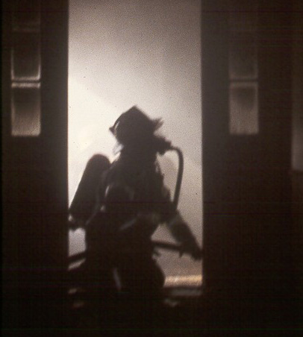
Lesson Five Firefighter I
TERMINAL OBJECTIVE
The Firefighter I candidate, when given a written exam, shall correctly identify and describe in writing dangerous building conditions created by fire and list techniques used in maintaining orientation.

Slide 80
Enabling Objectives
The Firefighter I candidate shall correctly identify in writing safety hazards encountered in buildings.
The Firefighter I candidate shall correctly identify in writing the reasons a firefighter can become trapped or disoriented within a building, and describe the steps to follow should this happen.

Slide 81
Building Hazards
There are a variety of hazards encountered in structures. Most however involve one or more of the following:
  Heavy content fire loading.
  Combustible furnishings and finishes.
  Wood-shake shingles.
  Wooden floors and ceilings.
  Large, open spaces.

Slide 82
Building Hazards
Maintaining orientation is critical to a firefighters survival.
Firefighters become disoriented when:
  There is an unexpected structural collapse.
  Doors close behind crews.
  Firefighters stray from hose or safety line.

Slide 83
Building Hazards
Upon becoming disoriented firefighters should:
  Remain calm and find cover from the fire.
  Activate PASS device.
  Remain with hose line or safety line.
  If available, make radio contact as quickly as possible with others on the scene.

Slide 84
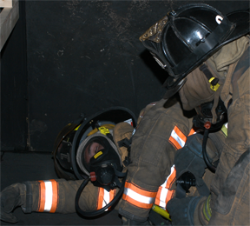
Review
Briefly review the types of dangerous building conditions that can jeopardize the safety of firefighters.
Review those procedures that firefighters can follow if and when they become disoriented or trapped in a building.

Slide 85
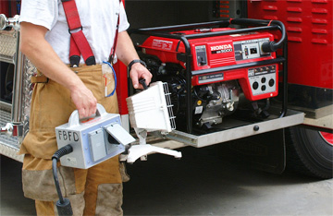
Lesson Six Firefighter I
TERMINAL OBJECTIVE
The Firefighter I candidate shall correctly identify and describe in writing the steps and hazards involving shutting off various utilities, as well as identify
safety procedures
when using fire
service lighting
equipment.

Slide 86
Enabling Objectives
The Firefighter I candidate shall correctly demonstrate the procedures for shutting off various utility services to a building, and the hazards associated with each.
The Firefighter I candidate shall correctly identify and describe in writing safety procedures when using fire service lighting equipment.

Slide 87
Controlling Utilities
The safest methods for firefighters to disconnect the electrical service from a building.
  If possible, shut off the main breakers at the electrical service box or panel.
  Do not cut outside wires or pull electrical meters.

Slide 88
Controlling Utilities
Reasons firefighters should not cut outside wires or pull electrical meters.
  Extreme electrical hazards exist if improper equipment is used when cutting drop wires to a building.
  Sometimes pulling a meter may not even stop the flow of electricity to the building.

Slide 89
Controlling Utilities
Positioning of the petcock on natural gas meters.
  Petcock is perpendicular to the pipe.
  A spanner wrench may be used to close most natural gas petcocks.
Utilities that are shut off because of fire operations, should not be restored by the firefighters due to liability.

Slide 90
Controlling Utilities
Policies governing electrical emergencies should cover:
  Notify power company personnel as soon as there is an electrical hazard.
  Let power company personnel handle energized electrical equipment if possible.
    The exception to this policy is when a life is in immediate danger, a rescue must be performed and the rescuer has the proper knowledge and equipment.
    This equipment must be certified to be dielectric by an approved testing agency, and the firefighter must be thoroughly trained in its use.

Slide 91
Controlling Utilities
Policies governing electrical emergencies should cover:
  Do not use solid or straight hose streams when a possible electrical hazard exists.
  Let pole top or cross arm fires burn until utility personnel shut down the power unless part of the pole or cross arm is in danger of falling.
    In this case, a fire extinguisher rated for Class C fires may be used to extinguish the fire.
    A firefighter may have to use a fire department aerial device to reach the fire.

Slide 92
Controlling Utilities
Policies governing electrical emergencies should cover:
  Exercise extreme caution when using all ladders around electrical hazards.
  When possible, avoid parking apparatus under overhead wires.
  OSHA 29 CFR 1926.550 states that aerial devices or ground ladders shall be kept a minimum of 10 feet from lines rated 50 KV or lower. For lines over 50 KV, the minimum clearance shall be 10 feet plus 0.4 inches for each 1 KV over 50KV, or use twice the length of line insulator but never less than 10 feet.

Slide 93
Controlling Utilities
Policies governing electrical emergencies should cover:
  Let only power company personnel cut electrical wire.
  Treat all wires as “live” high-voltage wires.
  Establish a danger zone of at least one span in either direction from downed power wires.
Wear full protective clothing when electrical hazards exist.

Slide 94
Lighting Equipment
Run power plants at least once a week for at least 20 minutes, while powering an electrical device.
Check fluid levels weekly. Check gas and oil levels after every use. Drain the power plant of all fluids if it is not to be in service for an extended period.
Wear gloves when changing quartz bulbs. Normal hand oil can cause a bulb to explode when it is energized.
Inspect electrical cords at weekly intervals to ensure that the insulation is not damaged.

Slide 95
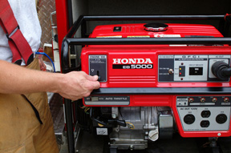
Lighting Equipment
Inspect the spark plug, spark plug wire, and carburetor at weekly intervals. A spare spark plug should also be readily accessible.
Test electrical devices for operating status while the power plant is running.
Change extra gasoline approximately every three weeks to ensure freshness.

Slide 96
Lighting Equipment
Electrical equipment cords and connectors should contain:
  12-gauge 3-wire is the most common.
  Adequately insulated.
  Waterproof.
  Twist lock connectors.
The ground-fault interrupter will shut off the electricity very quickly to reduce the severity of shock to the user.

Slide 97
Review
Review the aspects of controlling building utilities effectively and safely.
Review the procedures for setting up and maintaining lighting equipment with regard to firefighter safety.

Slide 98
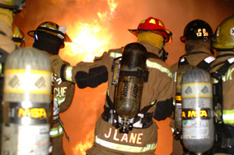
Lesson Seven Firefighter I
TERMINAL OBJECTIVE
The Firefighter I candidate, when given a written examination, shall correctly identify the potential long-term health
Consequences
of exposure to
the products of
combustion and
describe methods that will reduce the risk to the firefighter’s health.

Slide 99
Enabling Objectives
The Firefighter I candidate shall correctly identify in writing the potential long-term health consequences of exposure to the products of combustion.
The Firefighter I candidate shall correctly identify in writing the methods to reduce the long-term health effects of exposure to the products of combustion.

Slide 100
Exposure
The four common hazardous atmospheres associated with fires or other emergencies.
  Oxygen deficiency.
  Elevated temperatures.
  Smoke.
  Toxic atmospheres (with and without fire.)

Slide 101
Exposure
The common toxic gases associated with combustion.
  Carbon Dioxide.
  Carbon Monoxide.
  Hydrogen Chloride.
  Hydrogen Cyanide.
  Nitrogen Dioxide.
  Phosgene.

Slide 102
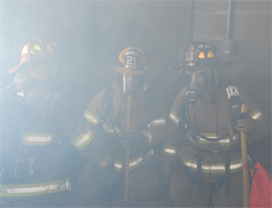
Exposure
The various diseases found in firefighters. Cancer is becoming the "firefighter disease."
  Heart disease.
  Cancer.
  Emphysema.
  Lung disease.

Slide 103
Exposure
Cancer-related facts.
  Cancer deaths for firefighters have doubled the past 30 years.
  Cancer in firefighters particularly strikes the lung, brain, intestine, rectum, colon lymphatic system, throat, mouth, and pancreas.
  Cancer deaths for firefighters are double that of the general public’s cancer death rate.
  Lung disease strikes firefighters more often than black lung strikes miners.

Slide 104
Exposure
Heart disease disables firefighters 55% more often than the people they serve and is the leading cause of death for firefighters.
Since 1950, the average age of death for firefighters from cancer or heart disease has dropped from 49 to 44 years.

Slide 105
Exposure
Some of the reasons why the threat of cancer has increased in firefighters.
  Increased exposure to cancer-causing agents. The products of synthetic chemicals have increased 350 fold since the end of World War II.
  Increased chemical hazards in the average home or office. Poisonous fumes given off from fire involving: furniture, toys, carpeting, appliances, clothing and insulation.
  Other common home items that can release cancer-causing substances include: Pesticides, herbicides, gasoline, and household cleaners.

Slide 106
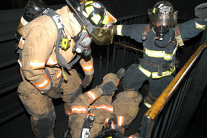
Reducing Exposure
Using S.C.B.A. along with all other personal protective equipment when entering any area where there is the potential to encounter the products of combustion.

Slide 107
Reducing Exposure
Firefighters can reduce their risk of cancer by:
  Staying healthy by eating well, getting the proper rest, obtaining medical checkups, and weight control.
  Exercising on a regular basis.
  Avoiding chemical habits by not smoking, abusing alcohol or taking non-prescribed drugs.
  Taking advantage of education and training relating to health and safety on the fire ground.

Slide 108
Reducing Exposure
Fire ground situations where there is a potential for firefighters to contract Carboxy-hemoglobin include:
  Fire attack.
  Building search.
  Overhaul operations.
  Fire Investigation (determining origin and cause.)

Slide 109
Review
Review the identified health-related illnesses that today’s firefighter faces.
Review each of the preventative measures firefighters should take to reduce the risk of exposure to the causes of long-term health problems.

Slide 110
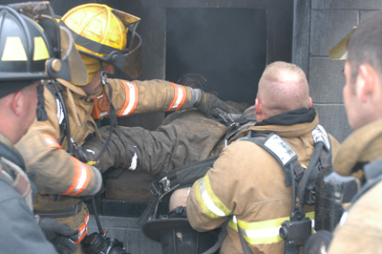
Lesson Eight Firefighter I
TERMINAL OBJECTIVE
The Firefighter I candidate shall correctly identify in writing the reasons for firefighter injuries and deaths in fire related and non-fire related activities.

Slide 111
Enabling Objectives
The firefighter I candidate shall correctly identify in writing the safety procedures for personnel on the fire ground.
The Firefighter I candidate shall correctly identify in writing the safety procedures while responding on the apparatus.
The Firefighter I candidate shall correctly describe in writing, the necessary elements to deploy and protect responders during an incident on a roadway.

Slide 112
Enabling Objectives
The Firefighter I candidate shall correctly identify in writing the procedures for safe training operations.
The Firefighter I candidate shall correctly identify in writing the procedures for ensuring a safe station / facility.

Slide 113
Fireground Operations
Exposure to fire products is one of the most frequent causes of injury and death on the fire ground.
  Examples include smoke, burns, back draft and flashover.
Falls are a common cause of injury and death on the fire ground.
  Examples include improper use of equipment or physical condition of the structure.

Slide 114
Fireground Operations
Sprains, strains, wounds and cuts are other types of injuries that generally occur due to misuse of equipment, improper lifting, and failure to wear protective clothing.
Some common causes of deaths and injuries resulting from lack of pre-fire planning.
  Lack of understanding of the overall fire scene .
  Type of construction.
  Age and contents of the building.
  Structural obstacles.

Slide 115
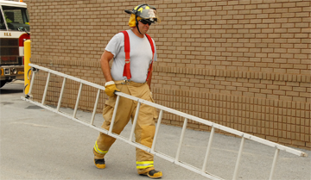
Fireground Operations
Hazards that might occur with improper apparatus placement, misuse of equipment and improper overhaul procedures.
  Unused ladders that are removed from the apparatus to get to other ladders should be moved to a safe location.

Slide 116
Fireground Operations
The officer’s role in fire ground safety is vital.
  The officer should be well trained to handle any situation and to ensure safety for all personnel.
Personnel accountability must be maintained at all times during fire ground operations.

Slide 117
Apparatus Safety
Firefighters should not don PPE while the apparatus is in motion.
All personnel riding apparatus should be in the fully enclosed portion of the cab with seatbelts on!
If sirens and noise level exceeds 90 decibels, hearing protection should be worn.

Slide 118
Apparatus Safety
Mounting and dismounting apparatus can be a hazard in and of itself.
  Watch for traffic.
  Have a firm grip on apparatus rails.
Review SOPs regarding responding and returning.
NFPA 1901 dictates the standard for new fire apparatus.

Slide 119
Roadway Safety
Placement of emergency vehicles and warning devices at a highway vehicle rescue incident.
  Upstream of an incident is the end of an incident where traffic is approaching.
  Downstream of an incident is the end of an incident where traffic is moving away.
  The transition area is the area where traffic is moved out of its normal path and redirected around the scene.
  The term block left means the first responding vehicle should be angled left towards the median.
  The term block right means the first responding vehicle should be angled to the right towards the outside shoulder of the road.
  The term buffer space is the protected area where first responders can properly perform their duties.

Slide 120
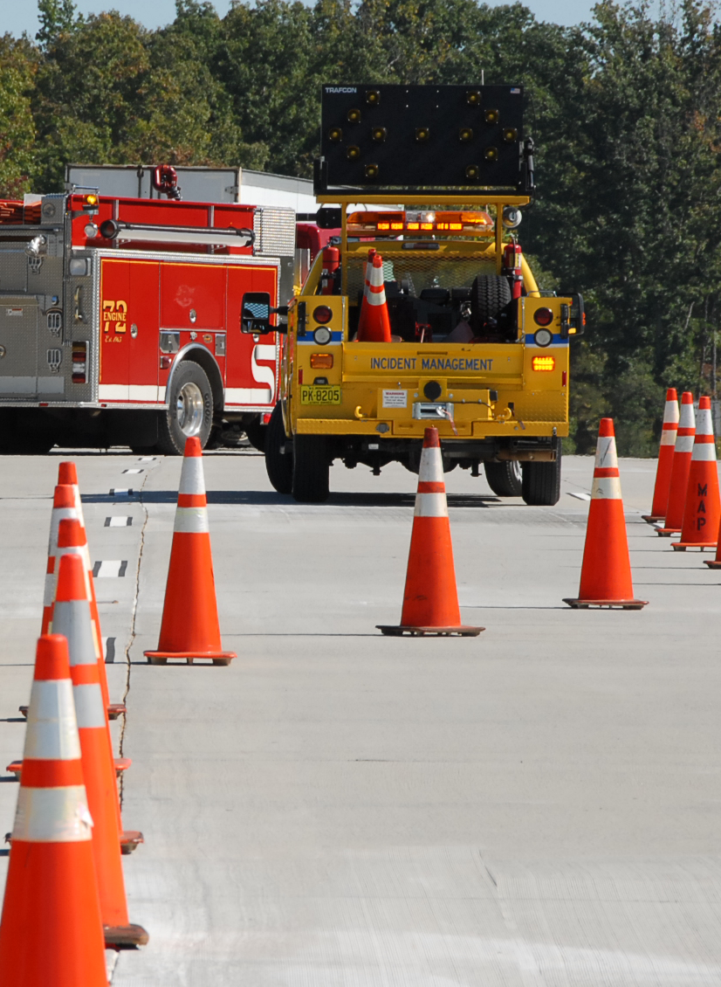
Roadway Safety
Traffic is typically redirected with a taper, which is basically a line of orange cones placed to show traffic
  Which way to move around
the scene.
  A properly positioned
  response vehicle can also
  be used, such as a fire or
  rescue vehicle with
  flashing lights, or both.
  NCDOT recommends that this practice be followed when setting up a taper with traffic cones.

Slide 121
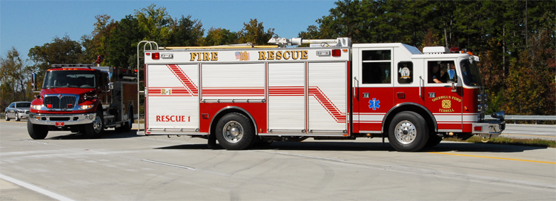
Roadway Safety
Goals of first arriving fire and rescue vehicles:
  Scene and personal safety.
  Patient extrication and treatment.
  Fire and spill control.
  Environmental impact containment.

Slide 122
Roadway Safety
Goals of first arriving EMS vehicles:
  Scene and personal safety.
  Rapid triage and treatment.
  Evaluation of transportation priority and method.
  Safe transportation.
EMS transport agencies should park on the downstream side of an incident. This allows for easy patient access without interfering in fire and rescue operations.

Slide 123
Roadway Safety
Goals of first arriving law enforcement vehicles:
  Scene and personnel safety.
  Securing evidence and enforcing motor vehicle laws.
  Information gathering and managing tow response.
  Clearing the scene and resuming traffic flow.
Law enforcement agencies should park at a distance on the upstream side of the incident.
  This allows oncoming motorists an advanced notification of the incident scene.

Slide 124
Roadway Safety
Goals of an Incident Management Patrol are:
  Set up short-term traffic control for other responders upstream of the incident or reroute traffic.
  Clear debris, including vehicles, from the roadway.
  Assist emergency responders.
  Restore traffic flow.

Slide 125
Roadway Safety
Role of the Towing and Recovery services as a key component to the restoration phase of the incident:
  Scene and personnel safety.
  Controlling and containing fluids.
  Removing debris.
  Clearing the scene.
Review the N.C. Highway Incident Safety
2009 training video from OSFM

Slide 126
Safe Training
Firefighters generally are well trained and have excellent equipment, yet deaths and injuries during training operations still occur. Identify the leading types of injuries.
  Sprains and strains often caused by improper lifting techniques, anxiety, improper use of equipment and others. Improper lifting techniques and slips and falls are the two most common activities that result in injury.
  Wounds and cuts often caused by failure to wear gloves and other protective clothing, as well as improper use of equipment.
  Burns caused by exposure to fire products are common.

Slide 127
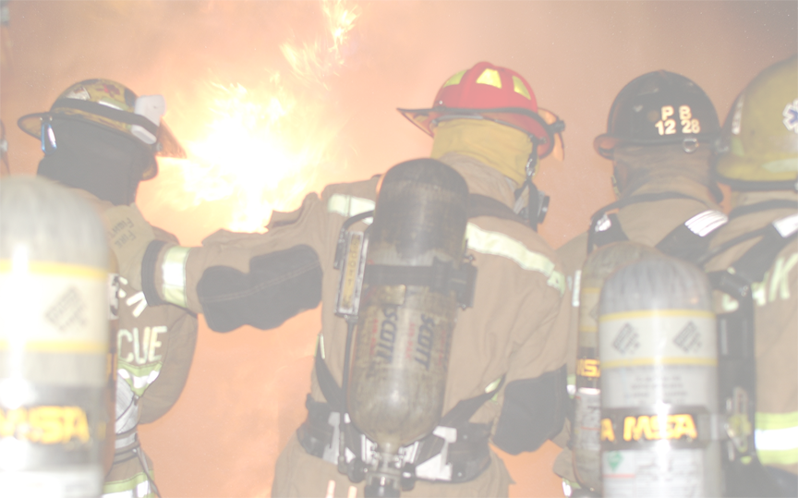


Safe Training
Before training sessions begin, the structure, equipment to be used, and other aspects of the operation should be examined.
Necessary repairs should be made to all of these before the training exercise begins.

Slide 128
Station Safety
Accidents in the station / facility include:
  Safety hazards in the fire station can result in accidents to firefighters and visitors. The Safety Officer should make sure all hazards are corrected.
  Accidents most associated with performing station duties include back strains, bruises, sprains and fractures. Back strain represents the most expensive in terms of cost and time out of work.
  Proper training in lifting and carrying can prevent many accidents listed above.

Slide 129
Station Safety
Prevent in-station accidents.
  Inspect the station on a regular basis to ensure good housekeeping.
  Appoint a station safety officer who can develop and implement safety procedures.
  Develop physical fitness safety guidelines for all personnel.

Slide 130
Review
Review in detail the safety procedures that the Firefighter I candidate should use on the fire ground.
Review each of the safety procedures for responding on fire department apparatus.

Slide 131
Review
Review all of the safety concerns that the Firefighter I candidate needs to be aware of when involved in a training exercise.
Review the requirements for maintaining a safe fire station or facility.

Slide 132
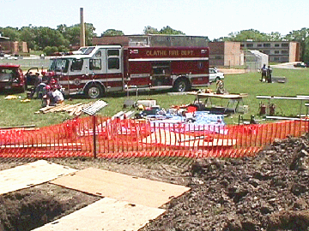
Lesson Nine Firefighter I
TERMINAL OBJECTIVE
The Firefighter I candidate shall correctly describe in writing the different work areas that must be established at
any emergency
incident and the
level of training
that personnel
will need in
order to function in each of these areas.

Slide 133
Enabling Objectives
The Firefighter I candidate shall correctly describe in writing the procedures for establishing work areas at any emergency scene.
The Firefighter I candidate shall correctly describe in writing the training requirements for emergency personnel to function in these work areas.

Slide 134
Control Zones
Pre-planning and establishing SOPs for response to emergency scenes and how tactical operations are planned is extremely beneficial.
This must be established by the AHJ for their equipment and personnel training levels.

Slide 135
Control Zones
The proper techniques for establishing work areas at any scene.
  Establish IMS.
  Scene Size-Up.
  Communication.
  Work Area Designations.
  Crowd Control.

Slide 136
Control Zones
There are different configurations for each type of response.
Pre-planning and training are the key to successful control zone set-up.

Slide 137
Review
Review with the Firefighter I candidates the correct procedures for establishing work areas at any emergency scene.
Review with the Firefighter I candidate the training requirements for emergency personnel to function in these work areas.

